Slide 1
JavaScript Objects
Module 11

Slide 2
Object Definitions

Slide 3
Objects
In JavaScript, everything can be an object.
Primitive values can be created as objects using new (don’t)
Everything else, like Math, Number, Date, Arrays, Functions, and Objects are always objects

Slide 4
Primitives
Primitive values have no properties or methods
Primitive Data Types are data with primitive values
JavaScript has 5 immutable primitive data types
String, Number, Boolean, null, and undefined

Slide 5
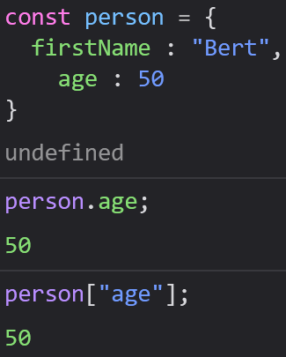
Object Properties
Objects are a complex data type containing key(name):value pairs
We call the named values properties
Objects written as name:value pairs are similar to
Hash Tables: C
Hash Maps: Java
Hashes: Ruby
Dictionaries: Python

Slide 6
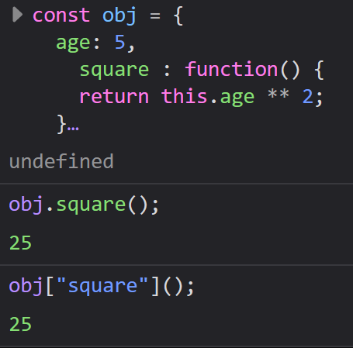
Object Methods
Methods are actions we can perform on objects
Methods are object properties containing a function definition

Slide 7
Creating Objects
Three different ways to create objects:
Define and Create a single object using an object literal (using curly braces like these {} )
Define and Create a single object with the new keyword (not recommended)
Define an object constructor in a class, and create many objects.

Slide 8
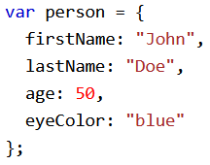
Using Object Literals ({})
Easiest way to make an object.
You can define your entire object on a single line, or on several, depending on what you think is easier to read

Slide 9
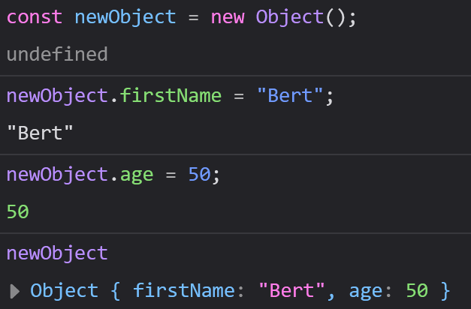
Using new Object()
We can create objects using new Object() as well, like this:
We can then add properties and values to it.
This method is less efficient in JavaScript

Slide 10
Using constructor()
We can use constructors with classes to create lots of objects
Constructors cover some broader topics that deserve their own section

Slide 11
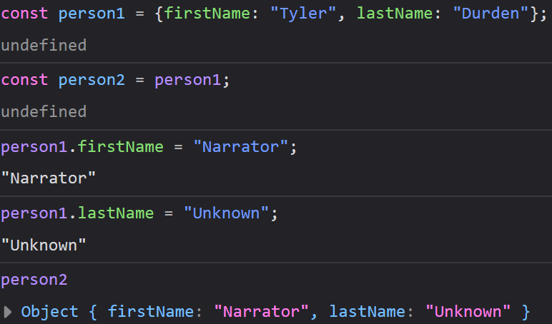
Objects are Mutable
Objects are addressed using a reference (variable), not their value.
In this example, we are creating a second variable, person2, and assigning person to it. This does not create a copy, just 2 references to the object

Slide 12
Object Properties

Slide 13
Properties
Properties are values associated with an Object
Object properties are unordered
They can usually be changed, added, or removed, but some are read-only.

Slide 14
Accessing Object Properties
Two ways to access properties:
objectName.property
objectName[“property”]
We can also use an expression instead of the property name with this syntax

Slide 15
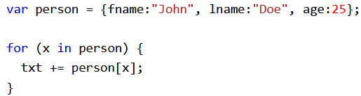
For/In Loops
For/In Loops will loop through an object’s properties once

Slide 16
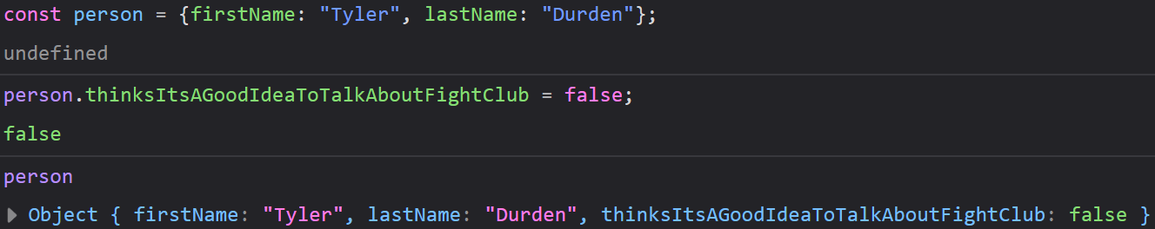
Adding New Properties
You can add new properties to an object just by giving it a value.
If that property already exists, it will change that properties value.

Slide 17
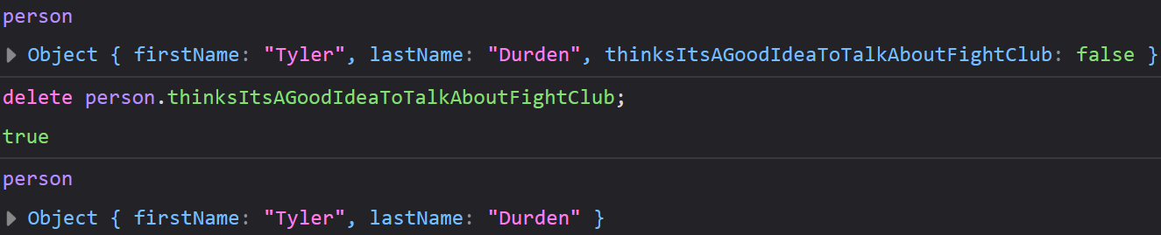
Removing Properties
The delete keyword will remove both a property and its value
delete is only for properties and will not affect variables/functions
DO NOT use delete on predefined object properties (such as prototype)

Slide 18
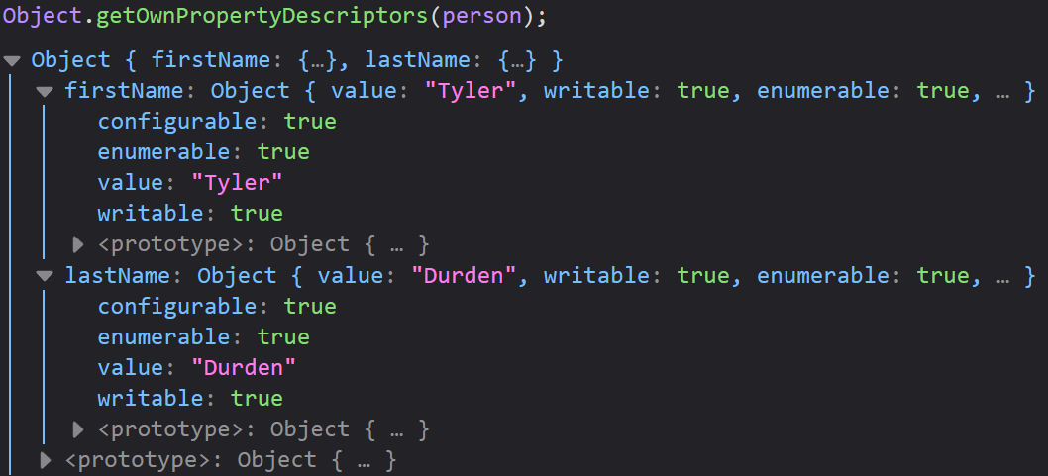
Property Attributes
All object properties have a name and a value.
Value is one of the property’s attributes
Other Attributes: enumerable, configurable, and writable

Slide 19
Object Methods

Slide 20
Methods
Actions that can be performed on an Object
Method: a property containing a function definition
Methods are stored as properties

Slide 21
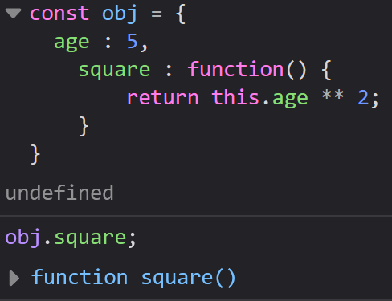
Accessing Object Methods
This will only execute if it is called (you used parentheses), otherwise it will return the function definition

Slide 22
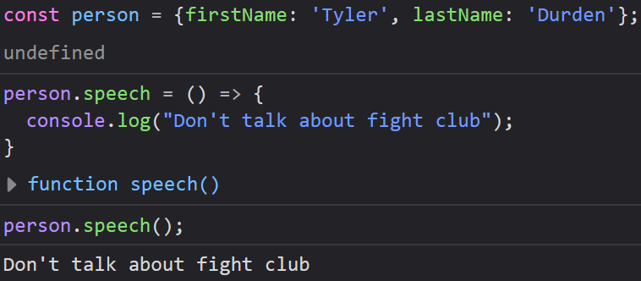
Adding Methods to Objects
We can add new methods to Objects the same way we add new properties
The example below uses an arrow function, but you are free to use the longer syntax as well

Slide 23
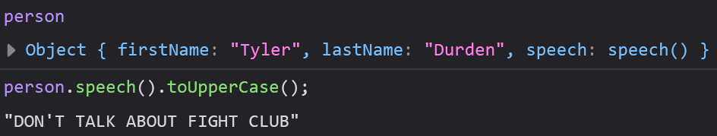
Built-In Methods
We can use all the built-in methods of each data type inside of our objects
You will often want to chain multiple methods together, like seen below

Slide 24
Object Display

Slide 25
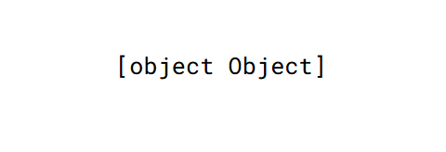
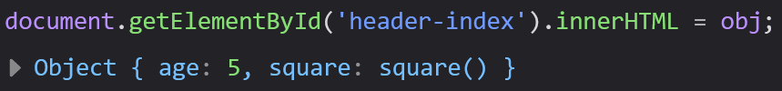
Displaying Objects
If you try to display an object, like on a webpage, it will show [object Object]
To get around this issue, we can display them using a property, looping through all properties, using Object.values(), or JSON.stringify()

Slide 26
Displaying Properties with a Loop
Looping through an Object’s properties is a useful way to display them
When we do this however, we must use this syntax: objectName[x], since only bracket notation allows variables

Slide 27
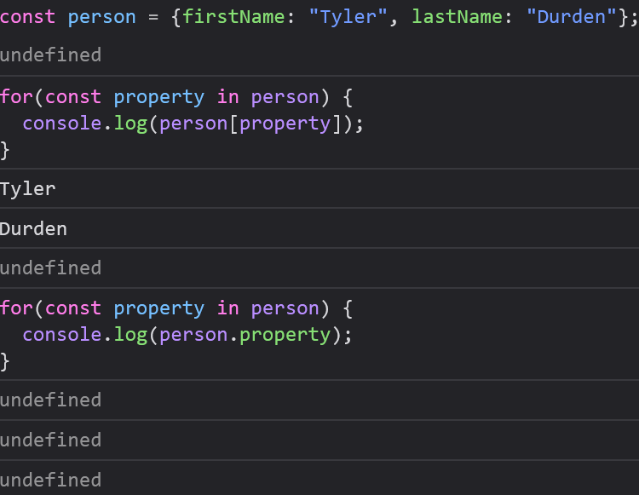

Slide 28
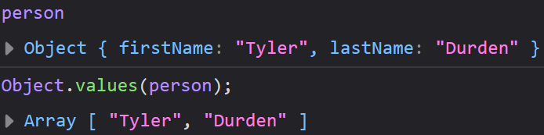
Using Object.values()
We can use Object.values() to convert an object into an array, which can be displayed normally.

Slide 29
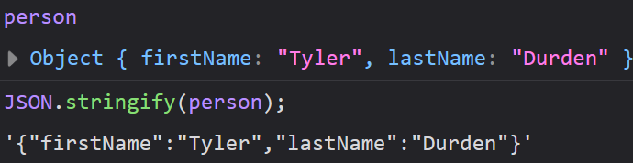
Using JSON.stringify()
Any JavaScript object can be converted to a string using the JSON.stringify() method

Slide 30

Using JSON.stringify()
JSON.stringify() will works well to display Dates as well
We can also use this on arrays

Slide 31
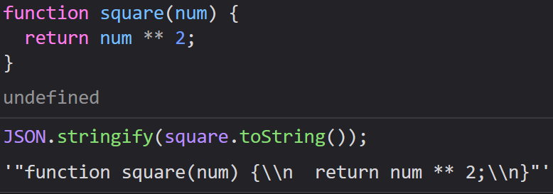
Displaying Functions
JSON.stringify() will not work on functions/methods in their normal form
To display them with JSON.stringify(), you must convert them to strings first

Slide 32
Object Accessors

Slide 33
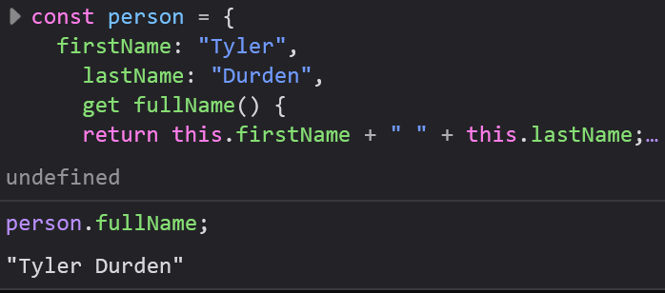
JavaScript “Getters”
get is a new keyword used to get the value of another property
We access getter methods like properties, since the idea is to access a property with them

Slide 34
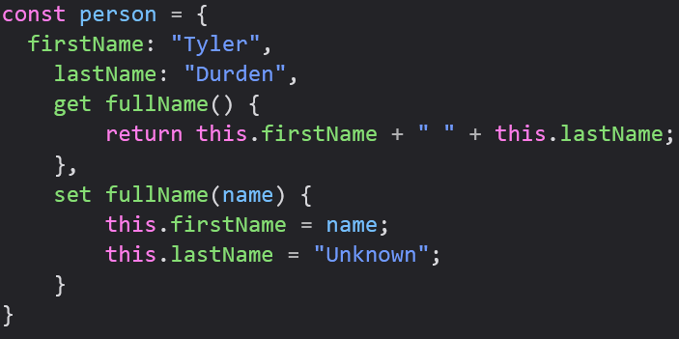
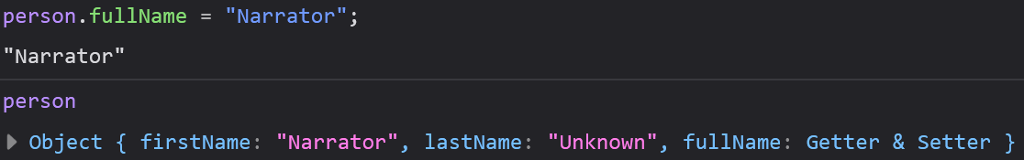
JavaScript “Setters”
set is a new keyword used to set the value of a property, similar to get.
We access setters like properties as well

Slide 35
Function vs Getter/Setter
We already know how to change property values, so what is the point?
Getters/Setters have a simpler syntax
Getters/Setters let you return data that matches the format you need, like letting us capitalize their first/lastName
Getters/Setters allow us to do things behind the scenes when we return data

Slide 36
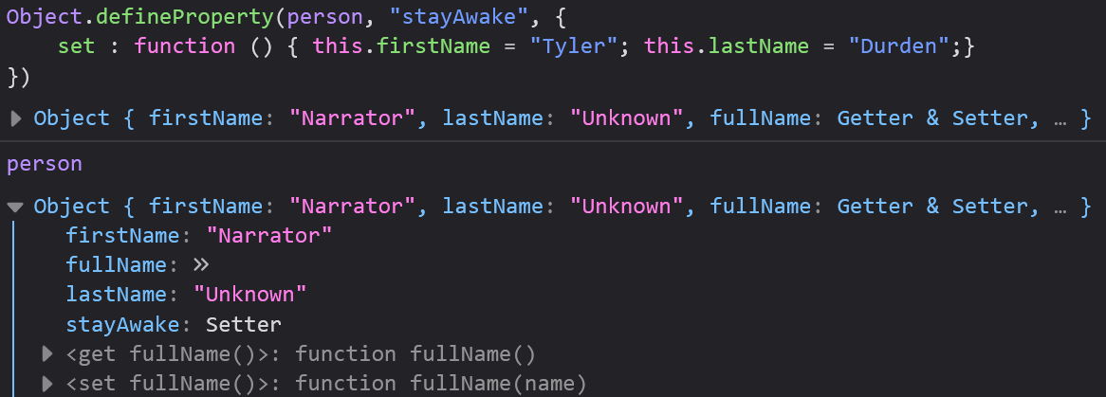
Object.defineProperty()
Object.defineProperty() allows us to add setter/getter methods to our objects

Slide 37
Constructors

Slide 38
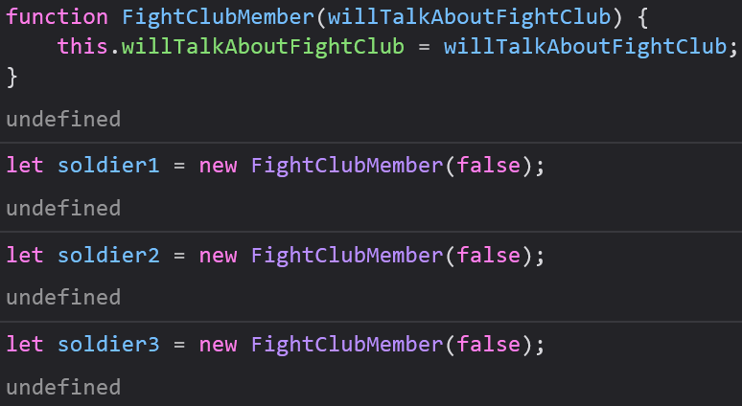
Object Types (Classes) (Blueprints)
Sometimes we need more than one of a certain kind of object to get something done
We can create many identical objects using an Object Constructor Function

Slide 39
this and Constructors
this usually refers to the object that “owns” the code, but when we make a constructor, there is no object yet
In the case of constructors, this will refer to the object it will create

Slide 40
Adding Properties to Your Constructor
It’s pretty easy to add a property to an object, but this will only add your property to that specific object
To add a property to all objects, you should add that property to your constructor

Slide 41
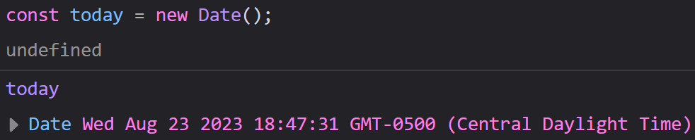
Built-In Constructors
Most data types have a built-in constructor to create an Object version of that type

Slide 42
Object Prototypes

Slide 43
Prototype Inheritance
All JavaScript objects inherit properties/methods from a prototype
Date inherits from Date.prototype
Array inherits from Array.prototype
Number inherits from Number.prototype

Slide 44
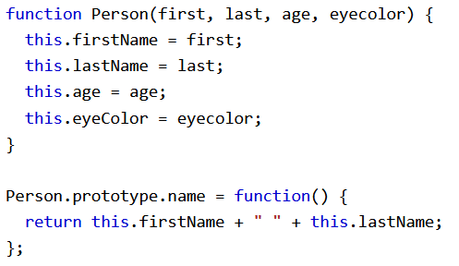
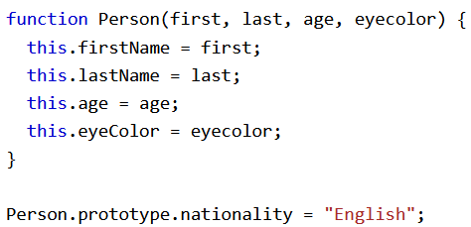
Adding Properties/Methods
We can use prototype to add properties or methods to all existing objects of a given type
We can also use prototype to add properties or methods to an object constructor

